Slide 1

Sankhyana Consultancy Services Pvt. Ltd.
Data Driven Decision Science
Neural Networks and Natural Language Processing

Slide 2
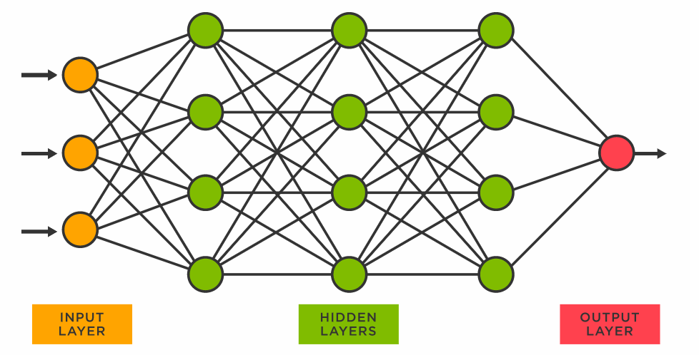
What is Neural Network?
A neural network is a series of algorithms that endeavors to recognize underlying relationships in a set of data through a process that mimics the way the human brain operates.
In this sense, neural networks refer to systems of neurons, either organic or artificial in nature.
Neural networks, also known as artificial neural networks (ANNs) or simulated neural networks (SNNs), are a subset of machine learning and are at the heart of deep learning algorithms.
Their name and structure are inspired by the human brain, mimicking the way that biological neurons signal to one another.

Slide 3
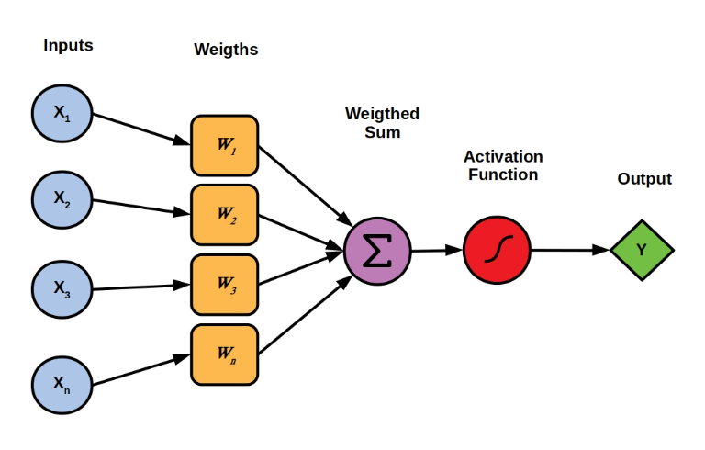
Multi-Layered Perceptron
In a multi-layered perceptron (MLP), perceptrons are arranged in interconnected layers. The input layer collects input patterns.
The output layer has classifications or output signals to which input patterns may map. For instance, the patterns may comprise a list of quantities for technical indicators about a security; potential outputs could be “buy,” “hold” or “sell.”
Hidden layers fine-tune the input weightings until the neural network’s margin of error is minimal.
It is hypothesized that hidden layers extrapolate salient features in the input data that have predictive power regarding the outputs. This describes feature extraction, which accomplishes a utility similar to statistical techniques such as principal component analysis.

Slide 4
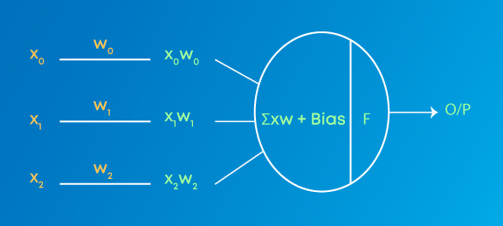
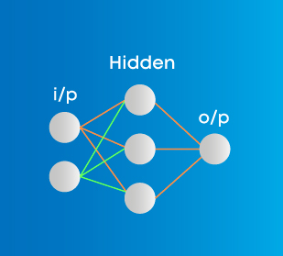
Weights are numeric values that are multiplied by inputs. In backpropagation, they are modified to reduce the loss. In simple words, weights are machine learned values from Neural Networks. They self-adjust depending on the difference between predicted outputs vs training inputs.
Activation Function is a mathematical formula that helps the neuron to switch ON/OFF.
Input layer represents dimensions of the input vector.
Hidden layer represents the intermediary nodes that divide the input space into regions with (soft) boundaries. It takes in a set of weighted input and produces output through an activation function.
Output layer represents the output of the neural network.

Slide 5
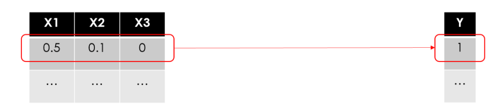
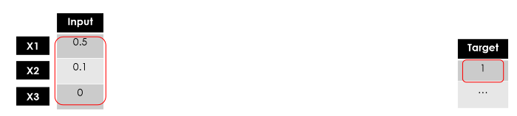
The simplest form of ANN is the Perceptron, a model with one layer only, very similar to the linear regression model. Asking what happens inside a Perceptron is equivalent to asking what happens inside a single node of a multi-layer Neural Network… let’s break it down.
Let’s say we have a dataset of N rows, 3 features and 1 target variable (i.e. binary 1/0):
Lets put some random numbers between 0 and 1 (data should always be scaled before being fed into a Neural Network).
Just like in every other machine learning use case, we are going to train a model to predict the target using the features row by row. Let’s start with the first row:

Slide 6
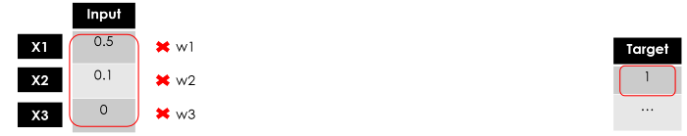
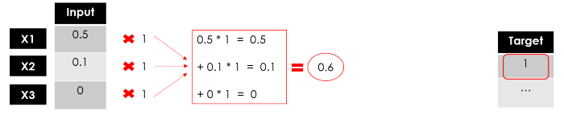
What does “training a model” mean? Searching for the best parameters in a mathematical formula that minimize the error of your predictions. In the regression models (i.e. linear regression) you have to find the best weights, in the tree-based models (i.e. random forest) it’s about finding the best splitting points…
Usually, the weights are randomly initialized then adjusted as the learning proceeds. Here I’ll just set them all as 1:

Slide 7
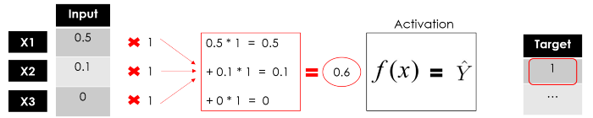
So far we haven't done anything different from a linear regression (which is pretty straightforward for the business to understand).
The activation function defines the output of that node. There are many and one can even create some custom functions. If we would set a simple linear function in our example, then we would have no difference from a linear regression model.

Slide 8
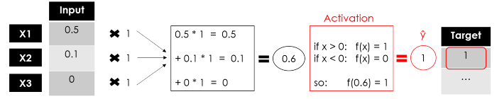
We have the output of our Perceptron, a single-layer Neural Network that takes some inputs and returns 1 output. Now the training of the model would continue by comparing the output with the target, calculating the error and optimizing the weights, reiterating the whole process again and again.

Slide 9


And here’s the common representation of a neuron:
Deep Neural Networks
One could say that all the Deep Learning models are Neural Networks but not all the Neural Networks are Deep Learning models. Generally speaking, “Deep” Learning applies when the algorithm has at least 2 hidden layers (so 4 layers in total including input and output).
Imagine replicating the neuron process 3 times simultaneously: since each node (weighted sum & activation function) returns a value, we would have the first hidden layer with 3 outputs.

Slide 10
Now let’s do it again using those 3 outputs as the inputs for the second hidden layer, which returns 3 new numbers. Finally, we shall add an output layer (1 node only) to get the final prediction of our model.
Remember that the layers can have a different number of neurons and a different activation function, and in each node, weights are trained to optimize the final result. That’s why the more layers you add, the bigger the number of trainable parameters gets.

Slide 11
You can review the full picture of a Neural Network:

Slide 12
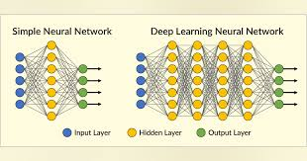
You can review the full picture of a Neural Network:

Slide 13
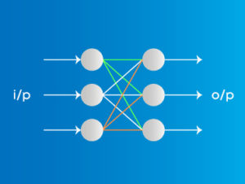
Types of Neural Networks
Feed-Forward Neural Networks
Feed-forward neural networks are one of the more simple types of neural networks. It conveys information in one direction through input nodes; this information continues to be processed in this single direction until it reaches the output mode. Feed-forward neural networks may have hidden layers for functionality.
Applications on Feed Forward Neural Networks:
Simple classification (where traditional Machine-learning based classification algorithms have limitations)
Face recognition [Simple straight forward image processing]
Computer vision [Where target classes are difficult to classify]
Speech Recognition

Slide 14
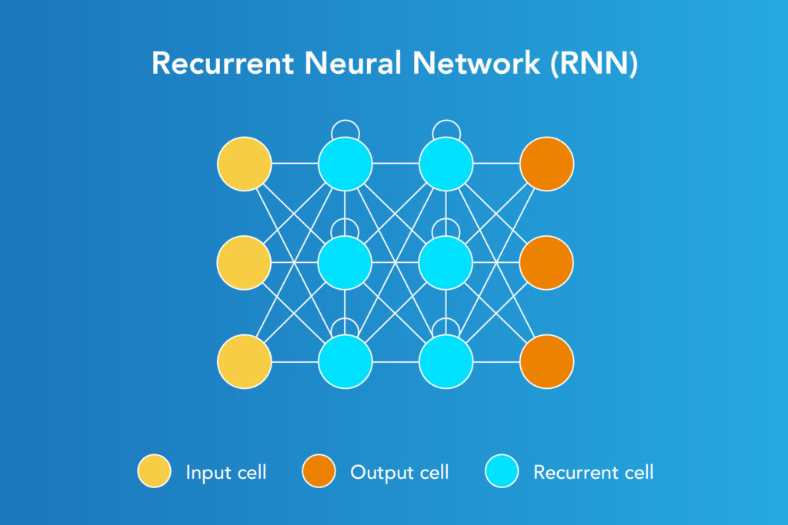
Types of Neural Networks
Recurrent Neural Networks
A more complex type of neural network, recurrent neural networks take the output of a processing node and transmit the information back into the network. This results in theoretical "learning" and improvement of the network. Each node stores historical processes, and these historical processes are reused in the future during processing.
This becomes especially critical for networks in which the prediction is incorrect; the system will attempt to learn why the correct outcome occurred and adjust accordingly.
Applications of Recurrent Neural Networks
Text processing like auto suggest, grammar checks, etc.
Text to speech processing
Image tagger
Sentiment Analysis
Translation

Slide 15
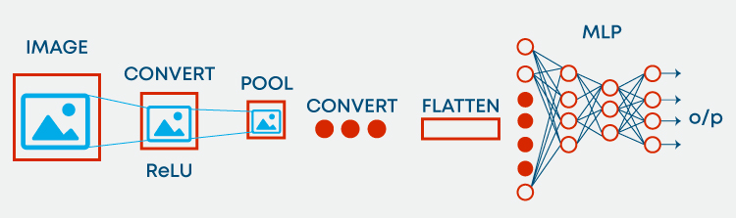
Types of Neural Networks
Convolution Neural Networks
Convolution neural networks, also called ConvNets or CNNs, have several layers in which data is sorted into categories. These networks have an input layer, an output layer, and a hidden multitude of convolution layers in between. The layers create feature maps that record areas of an image that are broken down further until they generate valuable outputs. These layers can be pooled or entirely connected, and these networks are especially beneficial for image recognition applications.

Slide 16
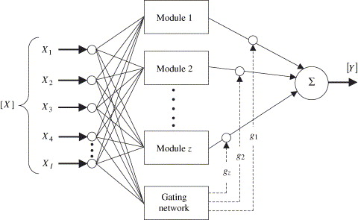
Types of Neural Networks
Modular Neural Networks
Modular neural networks contain several networks that work independently from one another. These networks do not interact with each other during an analysis process. Instead, these processes are done to allow complex, elaborate computing processes to be done more efficiently. Similar to other modular industries such as modular real estate, the goal of the network independence is to have each module responsible for a particular part of an overall bigger picture.
Applications of Modular Neural Network
Stock market prediction systems
Adaptive MNN for character recognitions
Compression of high level input data

Slide 17
Advantages
Can often work more efficiently and for longer than humans
Can be programmed to learn from prior outcomes to strive to make smarter future calculations
Disadvantages
Still rely on hardware that may require labor and expertise to maintain
May take long periods of time to develop the code and algorithms
Often leverage online services that reduce (but do not eliminate) systematic risk
Are continually being expanded in new fields with more difficult problems
May be difficult to assess errors or adaptions to the assumptions if the system is self-learning but lacks transparency
Usually report an estimated range or estimated amount that may not actualize

Slide 18

Natural Language Processing
One area where deep learning has dramatically improved in the last couple of years is natural language processing (NLP). Computers can now generate text, translate automatically from one language to another, analyze comments, label words in sentences, and much more.
Perhaps the most widely practically useful application of NLP is classification -- that is, classifying a document automatically into some category. This can be used for instance, for:
Sentiment analysis (e.g are people saying positive or negative things about your product)
Author identification (what author most likely wrote some document)
Legal discovery (which documents are in scope for a trial)
Organizing documents by topic
Triaging inbound emails
...and much more!

Slide 19
What is NLP?
Natural language processing (NLP) refers to the branch of computer science—and more specifically, the branch of artificial intelligence or AI—concerned with giving computers the ability to understand text and spoken words in much the same way human beings can.
NLP combines computational linguistics—rule-based modeling of human language—with statistical, machine learning, and deep learning models. Together, these technologies enable computers to process human language in the form of text or voice data and to ‘understand’ its full meaning, complete with the speaker or writer’s intent and sentiment.
A Product of Sankhyana Consultancy Services Pvt. Ltd.

Slide 20
Areas of NLP
Areas of NLP
Speech Recognition
Spell Check
Sentiment Analysis
Question Answering
Chat Bots
Text Classification
Machine Translation

Slide 21
Why NLP is considered hard?
‘’There was not a single man at the party”
Does it mean that there were no men at the party? or
Does it mean that there was no one at the party?
Here does man refer to the gender “man” or “mankind”?
“The chicken is ready to eat”
Does this mean that the bird (chicken) is ready to feed on some grains? Or
Does it mean that the meat is cooked well and is ready to be eaten by a human?
“Google is a great company.” and “Google this word and find its meaning.”
Google is being used as a noun in the first statement and as a verb in the second.

Slide 22
Why NLP is considered hard?
The man saw a girl with a telescope.
Did the man use a telescope to see the girl? or
Did the man see a girl who was holding a telescope?
Natural language is full of ambiguities. Ambiguity can be referred to as the ability to have more than one meaning or being understood in more than one way. This is a primary reason why NLP is considered hard. Another reason why NLP is hard is that it deals with the extraction of knowledge from unstructured data.

Slide 23
NLP task
Human language is filled with ambiguities that make it incredibly difficult to write software that accurately determines the intended meaning of text or voice data.
Homonyms, homophones, sarcasm, idioms, metaphors, grammar and usage exceptions, variations in sentence structure these just a few of the irregularities of human language that take humans years to learn, but that programmers must teach natural language-driven applications to recognize and understand accurately from the start, if those applications are going to be useful.

Slide 24



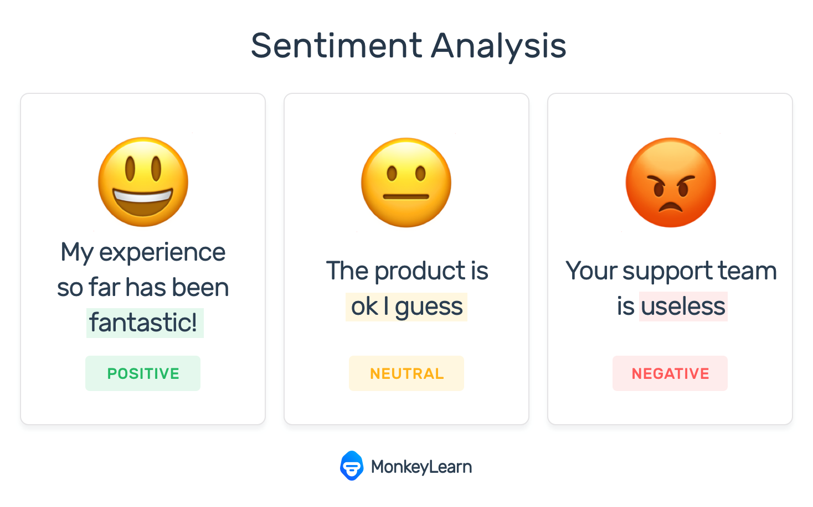
NLP task
Several NLP tasks break down human text and voice data in ways that help the computer make sense of what it's ingesting. Some of these tasks include the following:
Speech recognition
Part of speech tagging
Word sense disambiguation
Named entity recognition
Co-reference resolution
Sentiment analysis
Natural language generation

Slide 25
How does natural language processing work?
NLP enables computers to understand natural language as humans do. Whether the language is spoken or written, natural language processing uses artificial intelligence to take real-world input, process it, and make sense of it in a way a computer can understand. Just as humans have different sensors -- such as ears to hear and eyes to see -- computers have programs to read and microphones to collect audio. And just as humans have a brain to process that input, computers have a program to process their respective inputs. At some point in processing, the input is converted to code that the computer can understand.
Data Preprocessing
Algorithm Development

Slide 26

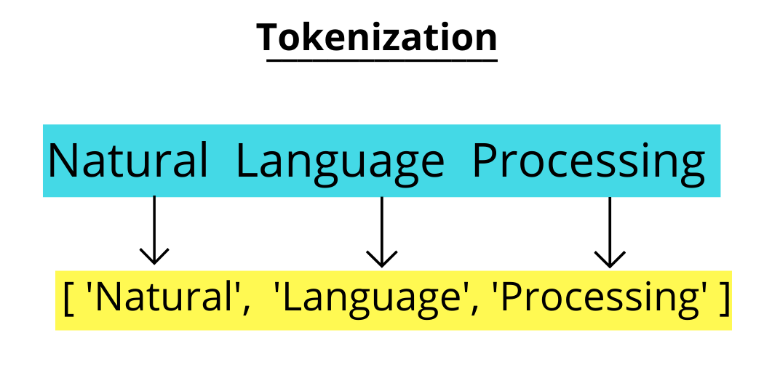
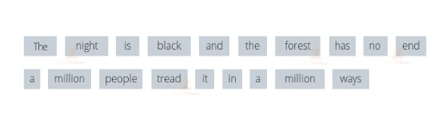
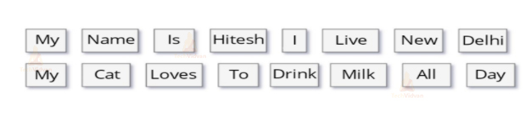
NLP preprocessing techniques
Tokenization
This is when text is broken down into smaller units to work with. The smaller units are called tokens

Slide 27
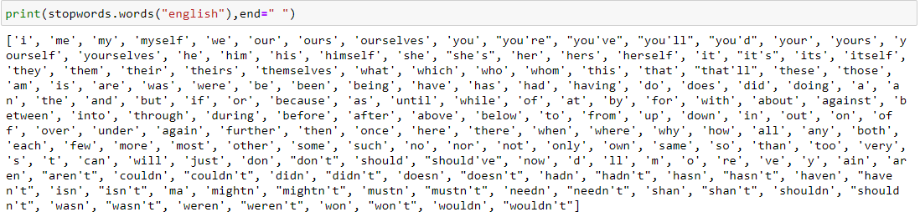
Stopwords
This is when common words are removed from text so unique words that offer the most information about the text remain.
Stopwords are commonly occurring words that are filtered out before processing the text

Slide 28
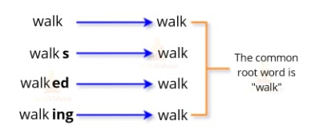
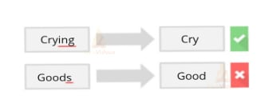
Stemming in NLP
This is when words are reduced to their root forms to process.

Slide 29
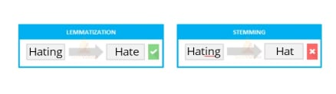
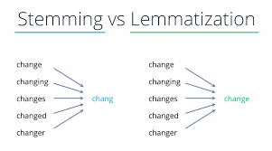
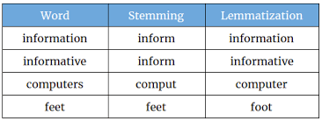
Lemmatization in NLP - process of reducing a word to its base or dictionary form, known as the lemma.

Slide 30
Techniques and methods of natural language processing
Syntax techniques:
Parsing
Word Segmentation
Sentence Breaking
Morphological Segmentation
Stemming
Semantics techniques:
Word sense disambiguation
Named entity recognition
Natural language recognition

Slide 31
Techniques and methods of natural language processing
Parsing: This is the grammatical analysis of a sentence. Example: A natural language processing algorithm is fed the sentence, "The dog barked." Parsing involves breaking this sentence into parts of speech -- i.e., dog = noun, barked = verb. This is useful for more complex downstream processing tasks.
Word segmentation: This is the act of taking a string of text and deriving word forms from it. Example: A person scans a handwritten document into a computer. The algorithm would be able to analyze the page and recognize that the words are divided by white spaces.
Sentence breaking: This places sentence boundaries in large texts. Example: A natural language processing algorithm is fed the text, "The dog barked. I woke up." The algorithm can recognize the period that splits up the sentences using sentence breaking.

Slide 32
Techniques and methods of natural language processing
Morphological segmentation: This divides words into smaller parts called morphemes. Example: The word untestably would be broken into [[un[[test]able]]ly], where the algorithm recognizes "un," "test," "able" and "ly" as morphemes. This is especially useful in machine translation and speech recognition.
Stemming: This divides words with inflection in them to root forms. Example: In the sentence, "The dog barked," the algorithm would be able to recognize the root of the word "barked" is "bark." This would be useful if a user was analyzing a text for all instances of the word bark, as well as all of its conjugations. The algorithm can see that they are essentially the same word even though the letters are different.

Slide 33
Techniques and methods of natural language processing
Semantics involves the use of and meaning behind words. Natural language processing applies algorithms to understand the meaning and structure of sentences. Semantics techniques include:
Word sense disambiguation: This derives the meaning of a word based on context. Example: Consider the sentence, "The pig is in the pen." The word pen has different meanings. An algorithm using this method can understand that the use of the word pen here refers to a fenced-in area, not a writing implement.

Slide 34
Techniques and methods of natural language processing
Named entity recognition: This determines words that can be categorized into groups. Example: An algorithm using this method could analyze a news article and identify all mentions of a certain company or product. Using the semantics of the text, it would be able to differentiate between entities that are visually the same. For instance, in the sentence, "Daniel McDonald's son went to McDonald's and ordered a Happy Meal," the algorithm could recognize the two instances of "McDonald's" as two separate entities -- one a restaurant and one a person.
Natural language generation: This uses a database to determine semantics behind words and generate new text. Example: An algorithm could automatically write a summary of findings from a business intelligence platform, mapping certain words and phrases to features of the data in the BI platform. Another example would be automatically generating news articles or tweets based on a certain body of text used for training.

